Slide 1

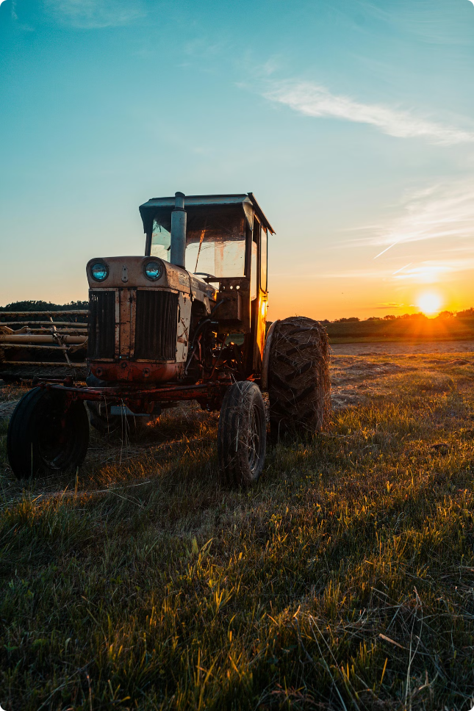

Agricultural Image Captioning for Smart Farming
Welcome to this presentation on agricultural image captioning. This technology revolutionizes farming by harnessing the power of computer vision to monitor crops and detect issues early.

Slide 2

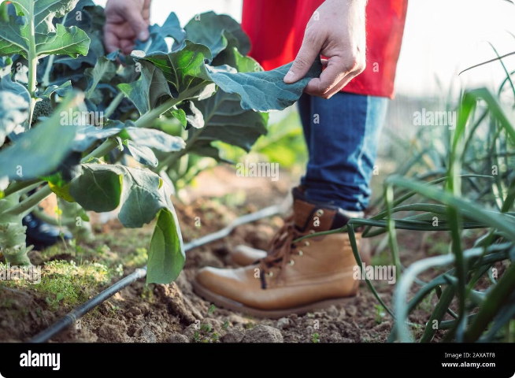
Introduction
1
Early Disease Detection
Diagnosing plant diseases early is crucial for maximizing crop yields and mitigating economic losses.
2
Image-Based Techniques
Image analysis provides a non-invasive and efficient way to monitor plant health and identify issues.
3
Model Development
We aim to develop a model capable of identifying crop conditions and generating descriptive captions from images.
4
Global Food Security
This technology has the potential to improve crop management practices and support global food security.

Slide 3
Problem Statement & Business Use Case
Problem Statement
Business Use Case
Our objective is to build a model that can automatically classify crop type, identify growth stage, and detect health issues like pests or diseases from images.
This tool can assist farmers and crop experts in monitoring crops remotely, detecting problems early, and optimizing resource management, ultimately leading to improved yields.

Slide 4

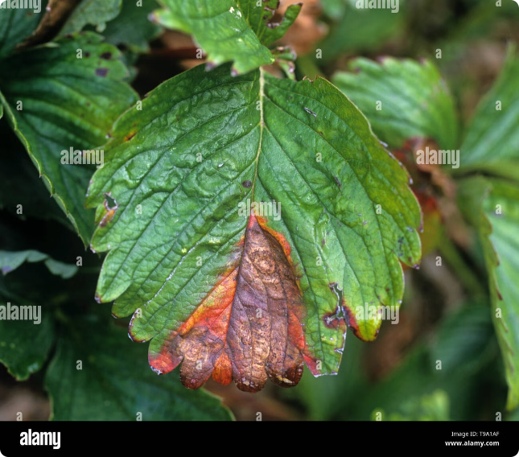
Dataset
Plant Pathology 2020 - FGVC7
This dataset, publicly available on Kaggle, comprises a vast collection of plant images annotated with disease information.
Image Content
The dataset contains images of various plant species, including fruit trees, vegetables, and grains, with detailed annotations on different diseases affecting them.
Model Training
This valuable dataset serves as the foundation for training our model to recognize and describe diverse crop conditions.

Slide 5

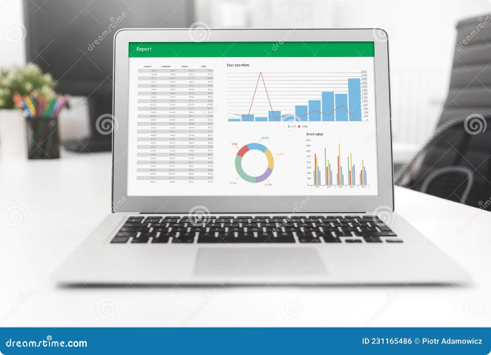
Exploratory Data Analysis (EDA)
1
Library Installation
We start by installing and importing necessary libraries, including TensorFlow, Keras, and OpenCV.
2
Data Loading & Hyperparameters
Next, we load the dataset and define key hyperparameters such as image size, batch size, and learning rate.
3
Image Visualization
Visualizing sample images and individual leaves provides insights into the dataset's characteristics and potential challenges.
4
Key Findings
EDA reveals that the blue channel plays a crucial role in detecting plant diseases, as it highlights subtle color changes often associated with infections.

Slide 6


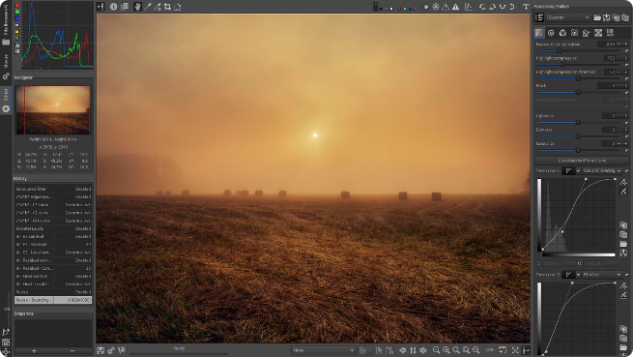


Image Processing and Augmentation
Canny Edge Detection
This technique enhances image features by detecting edges, making it easier for the model to identify shapes and structures associated with disease.
Flipping, Convolution, and Blurring
These techniques diversify the training data by creating variations of existing images, improving the model's ability to generalize to new scenarios.
Purpose
Augmentation is essential for improving model accuracy and reducing overfitting by exposing the model to a wider range of data variations.

Slide 7

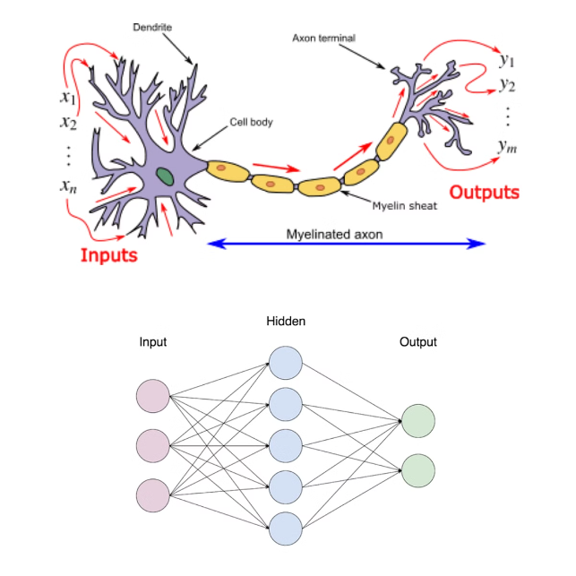
Modeling
Model
Description
Key Feature
DenseNet
A deep convolutional neural network known for its ability to reuse features effectively.
Feature reuse for enhanced representational power.
EfficientNet
A cutting-edge model designed for high performance and efficient scaling.
State-of-the-art performance with optimized model size.

Slide 8


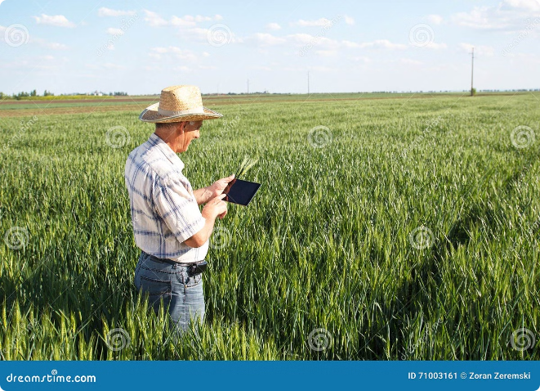


Conclusion
Performance
Our findings demonstrate that both DenseNet and EfficientNet achieve impressive accuracy in classifying crop conditions.
Efficiency & Scalability
EfficientNet slightly outperforms DenseNet in terms of efficiency and scalability, making it a preferred choice for larger datasets and real-world applications.
Future Directions
Future research will focus on further improving model accuracy, exploring the use of multi-modal data, and developing user-friendly interfaces for farmers and agricultural experts.

